Slide 1

Cloud Computing and Distributed Systems
Session-2 (Week-3)
Mayank Taneja,
Teaching Assistant

Slide 2
True or False ?
Consider the following statement?
“Leader Election problem is for each processor to decide that either it is the leader or non-leader, subject to the constraint that exactly one processor decides to be the leader.”
A. True
B. False

Slide 3
Choose the correct items for X, Y, and Z
There is no X algorithm for Y rings, even if algorithm knows the ring size (non-uniform) and Z model.
A. X- leader election, Y- anonymous, Z- synchronous
B. X- deadlock, Y- non-anonymous, Z- synchronous
C. X- symmetry-breaking, Y- non-anonymous, Z- asynchronous
D. X- leader election, Y- non-anonymous, Z- asynchronous

Slide 4
Anonymous -
If the processes do not have unique identifiers that can be used by the algorithm.
Every process has the same state machine.
Otherwise, the algorithm is called eponymous (or non-anonymous)
Uniform -
If n is not known to the algorithm, the algorithm is called uniform.
The algorithm looks the same for every value of n.
n is not explicitly present in the code.
Synchronous -
All the links between the nodes have same latency
Each message will reach the other node in roughly same time

Slide 5
Every processor begins in same state with same
outgoing messages (since anonymous)
Every processor receives same messages, does same
state transition, and sends same messages in round 1
Ditto for rounds 2, 3, ...
Eventually some processor is supposed to enter an
elected state. But then they all would.

Slide 6
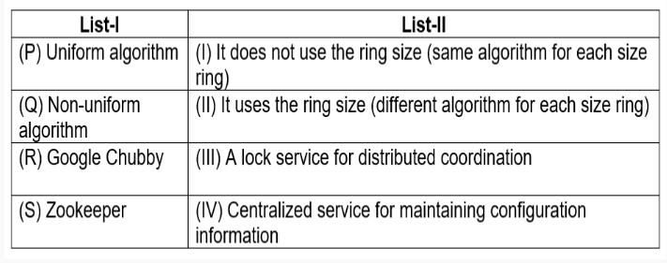
Match the following two list:
A. (P):I, (Q): II, (R): III, (S): IV
B. (P):III, (Q): IV, (R): II, (S): I
C. (P):II, (Q): I, (R): IV, (S): III
D. (P):III, (Q): II, (R): I, (S): IV

Slide 7
Zookeeper vs Chubby
Zookeeper is a distributed process coordinator, Chubby is a distributed lock service
Both have different levels of consistency, chubby provides stronger consistency, whereas zookeeper provides weaker consistency - eventual consistency

Slide 8
What is coordination?
Group membership: Set of datanodes (tasks) belong to same group
Leader election: Electing a leader between primary and backup
Dynamic Configuration: Multiple services are joining, communicating and leaving (Service lookup registry)
Status monitoring: Monitoring various processes and services in a cluster
Queuing: One process is embedding and other is using
Barriers: All the processes showing the barrier and leaving the barrier.
Critical sections: Which process will go to the critical section and when?
In very simple words, it is a central store of key-value using which distributed systems can coordinate. Since it needs to be able to handle the load, Zookeeper itself runs on many machines.

Slide 9
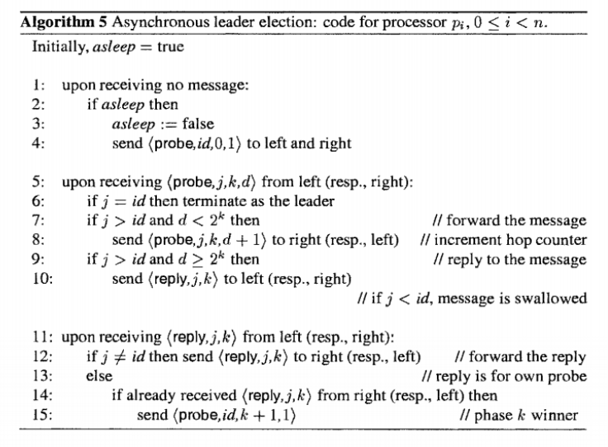
Find the message complexity of below algorithm:
A. O(n2) Messages
B. O(logn) Messages
C. O(nlogn) Messages
D. O(n3) Messages

Slide 10
LCR Algorithm
send value of own id to the left
when receive an id j (from the right):
if j > id then
• forward j to the left (this processor has lost)
if j = id then
• elect self (this processor has won)
if j < id then
• do nothing

Slide 11
Consider the following statements:
Statement 1: In the Hirschberg and Sinclair (HS) algorithm, at each phase the number of (phase) winners is cut approximately in half.
Statement 2: In the Hirschberg and Sinclair (HS) algorithm, the number of messages initiated by a processor in phase k is at most 2k (probes and replies in both directions)
A. Only statement 1 is true
B. Only statement 2 is true
C. Both statements are true
D. Both statements are false

Slide 12
Consider the following statements:
Statement 1: ZooKeeper is a highly reliable distributed coordination kernel, which can be used for distributed locking, configuration management, leadership election, work queues.
Statement 2: ZooKeeper is a central store of key-value using which distributed systems can coordinate. Since it needs to be able to handle the load, Zookeeper itself runs on many machines.
A. Only statement 1 is true
B. Only statement 2 is true
C. Both statements are true
D. Both statements are false

Slide 13
True or False ?
Ephermal node gets deleted if the session in which the node was created has disconnected. Though it is tied to client's session but it is visible to the other users.
A. True
B. False

Slide 14
Znode
We store data in an entity called znode.
The data that we store should be in JSON format which Javascript object notation.
The znode can only be updated. It does not support append operations.
The read or write is atomic operation meaning either it will be full or would throw an error if failed. There is no intermediate state like half written.
Can have children

Slide 15
Znode - Types
Persistent
Such kind of znodes remain in zookeeper until deleted. This is the default type of znode.
Ephemeral
Ephermal node gets deleted if the session in which the node was created has disconnected. Though it is tied to client's session but it is visible to the other users.
An ephermal node can not have children not even ephermal children.

Slide 16
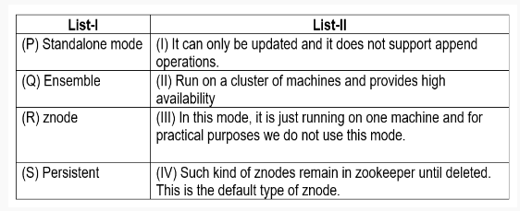
Match the following two list related to Zookeeper architecture:
A. (P):I, (Q): II, (R): III, (S): IV
B. (P):III, (Q): IV, (R): II, (S): I
C. (P):II, (Q): I, (R): IV, (S): III
D. (P):III, (Q): II, (R): I, (S): IV

Slide 17
Architecture
Zookeeper can run in two modes: (i) Standalone and (ii) Replicated.
Standalone:
In standalone mode, it is just running on one machine and for practical purposes we do not use standalone mode.
This is only for testing purposes.
It doesn't have high availability.
Replicated:
Run on a cluster of machines called an ensemble.
High availability
Tolerates as long as majority.

